Slide 1
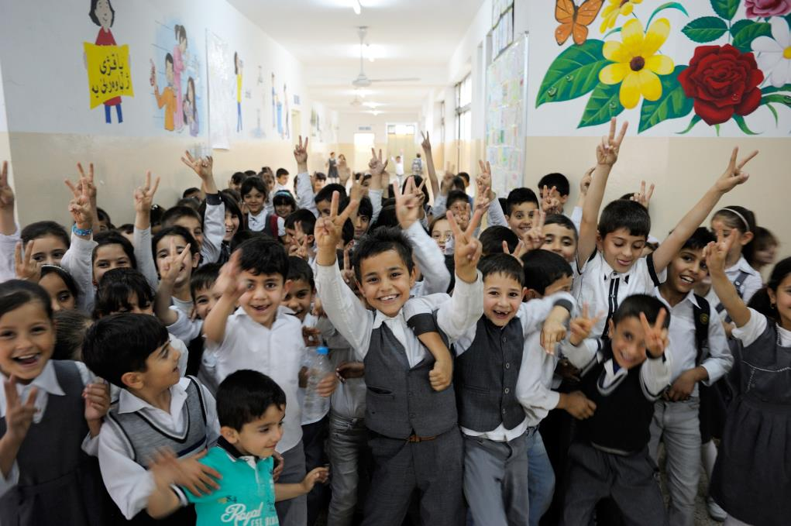
Ein Schritt nach vorne
© UNICEF/UNI194357/Mackenzie

Slide 2
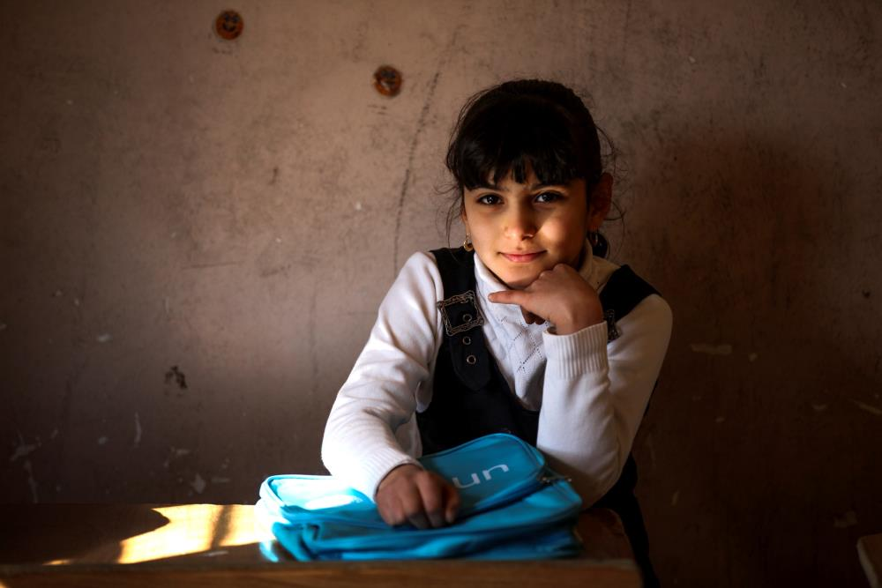
Janna, 8 Jahre alt und aus Baghdad, Irak. Sie hat das Glück in die Schule gehen zu dürfen. Mehr als zwei Millionen irakische Kinder können das nicht.
© UNICEF/UN08244/Khuzaie
Notes:
On 16 January 2016, Janna, 8, from Baghdad, sits in a classroom with her new UNICEF school bag after a school supply distribution for children from five schools in Baghdad's Al-Amiriyah District. In the last year, UNICEF has facilitated the distribution of learning materials to more than 346,000 children across the country. The impact of conflict, violence and displacement has devastated Iraq's education system. Nearly 2 million children are currently out of school, with an additional 1.2 million at risk of dropping out. Almost 1 in 5 schools across the country cannot be used as a result of the ongoing conflict. Of the schools that remain in use, thousands are overburdened, with large class sizes and many schools operating in multiple shifts.

Slide 3
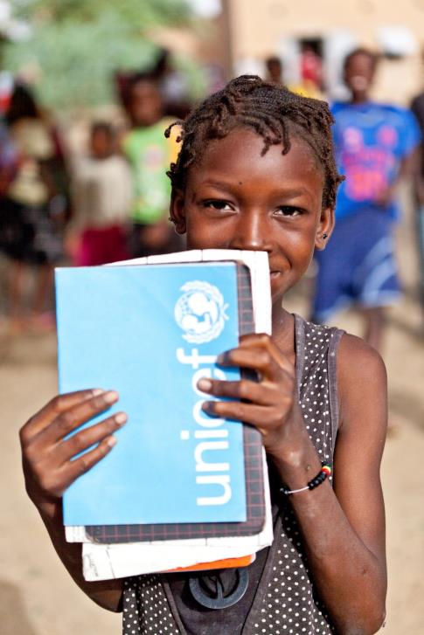
Fatouma, 10 Jahre alt und aus Mali. Sie geht momentan zur Schule, jedoch wird ihre Stadt Timbuktu oft von Rebellen besetzt, wodurch sie nicht immer zur Schule gehen kann.
© UNICEF/UNI146414/Dicko
Notes:
Ten-year-old Fatouma Wangara is one of the students at the ‘Bahadou 2’ school in Timbuctu that benefitted from UNICEF school kits. Thanks to the support provided to her school by UNICEF after the occupation by rebels, she now attends classes regularly. The Timbuctu region is situated about 1050 km from the capital Bamako and is the 6th and largest region of Mali.

Slide 4
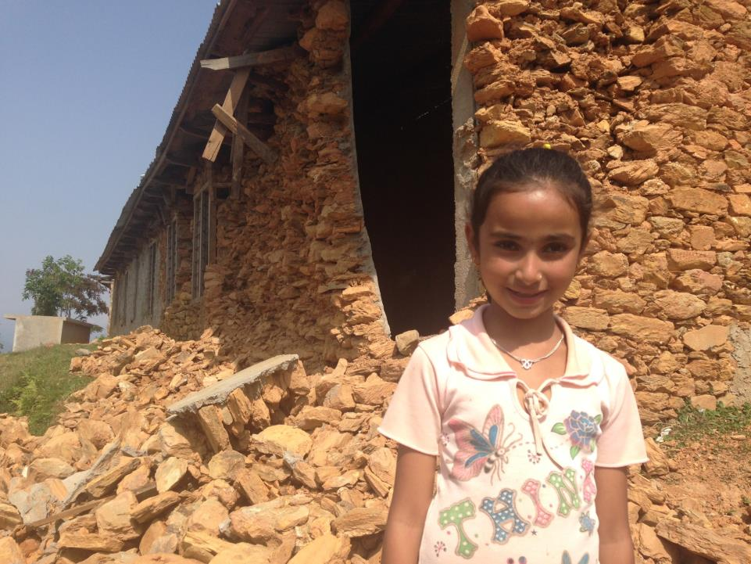
Ashima, acht Jahre als und aus Nepal. Durch das verheerende Erbeben 2015 wurde jedoch ihre Schule zerstört. Momentan wird die Schule noch aufgebaut. Ihr Lieblingsfach bisher war Englisch.
© UNICEF/UNI183839/Page
Notes:
8 year old Ashima stands outside her earthquake damaged school in her mountain top village of Maidi, Dhadang District, Nepal - not far from the epicenter of the earthquake. The giant hole in the wall makes her class-room unusable. "I am sad that my school is broken. I want it to be fixed so my friends and I can be learning again. My favorite subject is English." Today, UNICEF Nepal reached Maidi where hygiene kits were distributed and two medical tents were provided to the Dhadang Hospital.

Slide 5
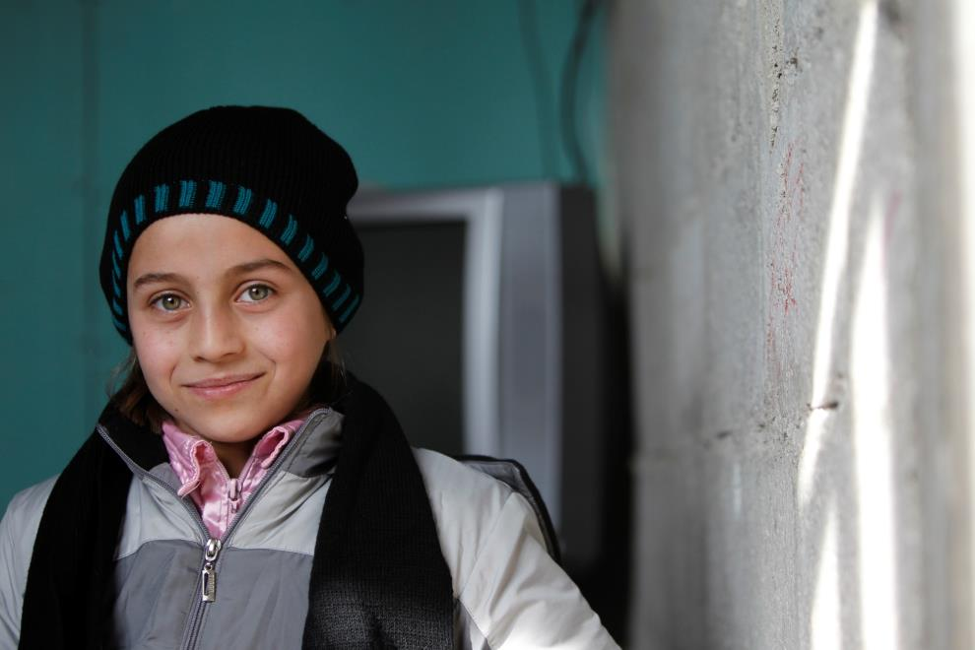
Teba, elf Jahre alt und aus Syrien möchte einmal Ärztin werden. Aufgrund des Krieges musste sie jedoch sechsmal in den letzten drei Jahren fliehen und lebt nun in sehr gefährlichen Verhältnissen in Damaskus.
© UNICEF/UN02933/Sanadiki
Notes:
Teba, 11, wearing the winter clothes she received from UNICEF. “I want to become a doctor when I grow up.” Teba said. Some children and their families have been displaced multiple times because of the war. Teba is one of them. Teba and her family have been displaced six times in the last three years. They now live in an unfinished building in Al Ghizlanieh on the outskirts of Damascus. Teba lives with her father and other three siblings in a small apartment in a poorly insulated building.

Slide 6
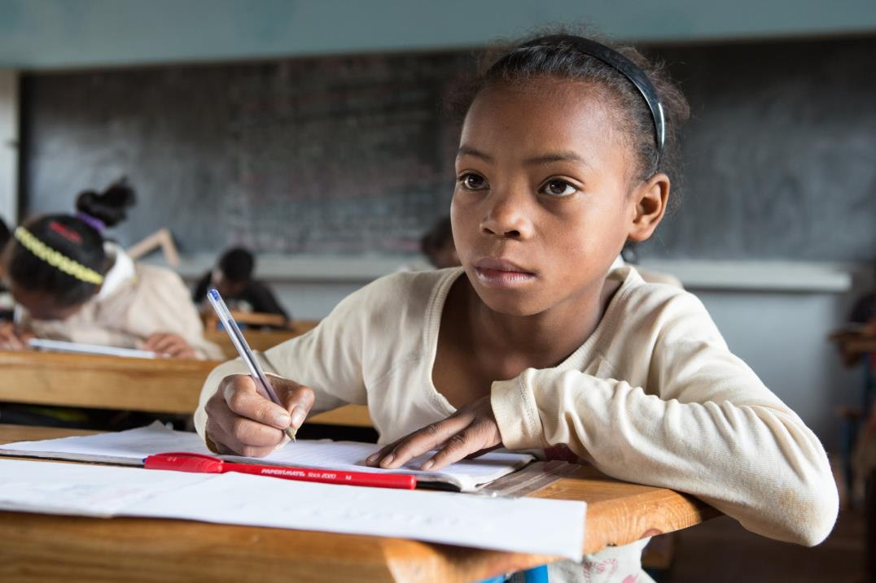
Tiavina, 12 Jahre als aus Madagaskar liebt Geschichte in der Schule. Sie kann sich aber oft nicht konzentrieren, weil
sie Hunger hat. Sie hat acht Geschwister und ihre Eltern haben kaum Geld für Essen.
© UNICEF/UNI180130/Matas
Notes:
On 25 February, Tiavina Rasoaremalala, 12, looks up from her classwork, at Lohanosy Primary School in Lohanosy Village in Analamanga Region. “I like studying science and history at school. My dream is to finish school and become a teacher,” she said. Tiavina is one of nine children in her family, which struggles to pay for both food and school. Her parents grow rice to feed the family, and her mother also makes and sells rope, to buy for food and clothing and to pay the children’s school fees. “For me, it’s very difficult to follow [along] at school because we don’t eat enough at home, and I often have a stomach ache,” Tiavina said. “If my parents don’t work, we don’t have enough food.” UNICEF supported construction of classrooms, the water and sanitation facilities and a sports field, as well as promotes good hygiene practices at the model primary school, which is built on land donated by the community, and with support from the Ministry of Education and the private sector.

Slide 7
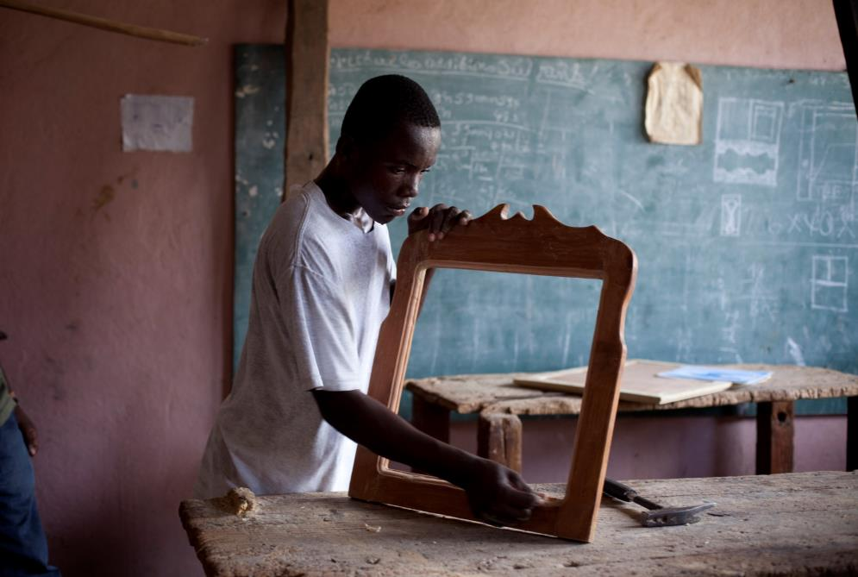
Thomas, 16 Jahre alt aus Haiti macht eine Tischlerlehre in einem Zentrum für Straßenkinder. Er und seine drei Geschwister haben drei Jahre lang auf der Straße gelebt und keine Schule besucht.
© UNICEF/UNI89218/Ramoneda
Notes:
Thomas Daniel, 16, attends carpentry class at the Lakou centre for street children and youth in Port-au-Prince, Haiti. Thomas has been in the center for a year, and has two more left to get his certificate. He went to the center motivated by a friend and to find something better for his future. He's been living in the streets for 3 years together with 3 other older siblings. He would like to open his own shop when he finishes, although he admits that he will have economic problems to start his own business. After class he works washing cars. The center works to reinsert children into society and allows those up to 16 years old to sleep there. They also give the chance to those between 14 to 16 years old who are motivated to attend their boarding school so they can continue with their studies. The center also works with over 16-year-old street children and youth, teaching them a profession and giving them one meal per day after the morning classes, before they go back to the streets. The centre also ensures that HIV positive street children follow their treatments by being visited by their medical team. This center is not currently funded by UNICEF.

Slide 8
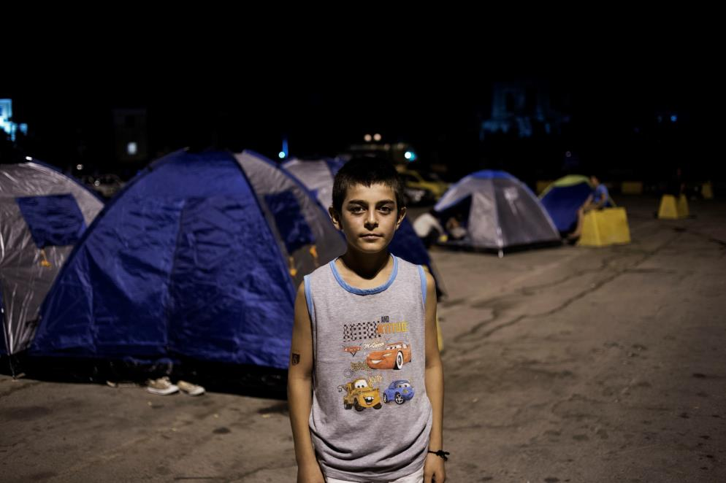
Mustapha, 13 Jahre alt, kommt aus Aleppo in Syrien. Er flüchtete im September 2015 nach Deutschland, um ein neues Leben zu beginnen und wieder in die Schule zu gehen. Bei der Überfahrt nach Griechenland ertranken er und seine Familie fast.
© UNICEF/UNI197053/Romenzi
Notes:
On 12 September 2015, Mustapha, 13, stands outside a tent in Idomeni in Greece. Mustapha is from Aleppo and is on his way to Germany. Departing from Turkey, he arrived in Lesbos with his mother, his brother, his sister-in-law and his niece, after a harrowing boat trip. Mustapha says "The boat was full of people and the smugglers where cramming people in. I was afraid the boat would split into two. We will fall into the water. We will drown, suffocate and die. But luckily we didn’t."

Slide 9
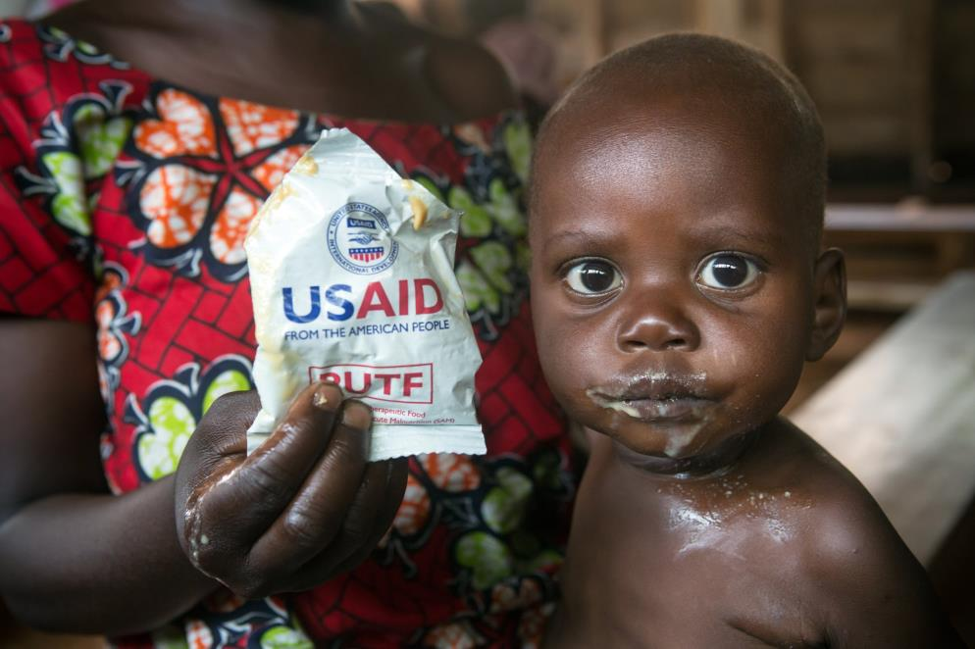
Byamungu, 13 Monate alt aus der Demokratischen Republik Kongo, leidet aufgrund von Armut und fehlenden Ressourcen an akuter Unterernährung. Wenn er nicht so schnell wie möglich Hilfsnährstoffe erhält, wird sein Gehirn beeinträchtigt sein und er wird sehr große Probleme in der Schule und Zukunft haben.
© UNICEF/UN07635/Dubourthoumieu
Notes:
The mother of Byamungu Selemani, a 13 months old boy suffering of malnutrition, is feeding him with ready-to-use therapeutic food provided by USAID, in the Ambulatory Therapeutic Nutrition Unit of Nyakakoba, managed with the support of UNICEF, situated 30 km south of Walungu, in the South Kivu Province of the Republic Republic of the Congo, on September 25th, 2015.

Slide 10
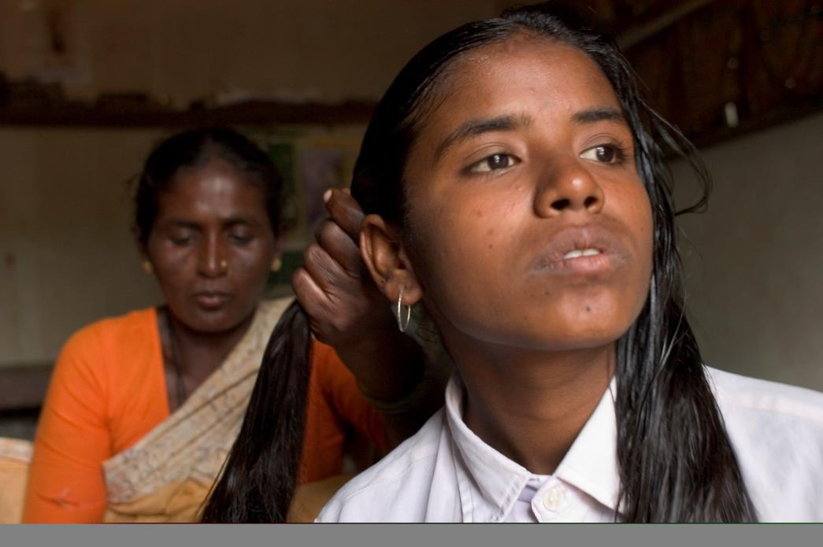
Madhavi lebt in einem kleinen Dorf in Andhra Pradesh, Indien. Ihre Schule ist sechs Kilometer entfernt. Ein Jeep fährt normalerweise drei Mal am Tag zur Schule. Während des Monsuns muss sie aber zuhause bleiben. Sie erledigt nebenbei den Großteil der Hausarbeit.
© UNICEF/UNI91701/Taylor
Notes:
Madhavi lives in a rural village 6 km. from the nearest school. The only road to the school is a dirty track that winds its way around the fields. During the monsoons the roads are inaccessible, even by the local jeep that makes the journey into town three times a day. On those days, Madhavi will stay at home. Sometimes, when the jeep is too full and there isn’t room even on the roof, she will walk the hour and a half journey. Other times, her father, a landless laborer, cannot afford the Rs. 2/- jeep fee. Madhavi is also expected do the majority of the housework. She has two older sisters and two younger brothers.

Slide 11
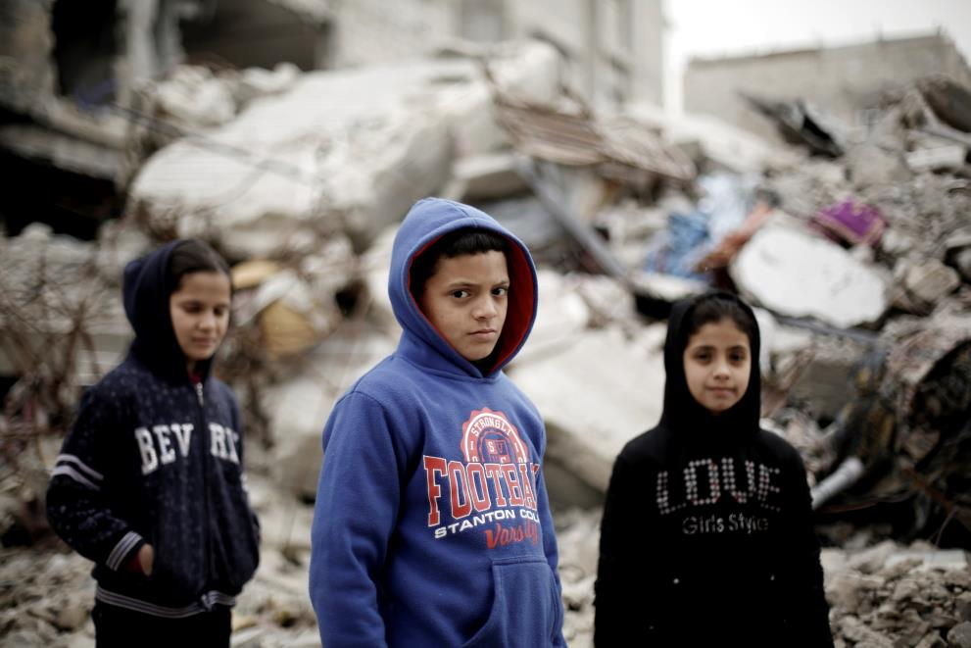
Salah Haijaj, neun Jahre alt aus den Palästinensischen Autonomiegebieten. Sein Vater und Onkel starben durch Bombenanschläge am Gazastreifen. Nun lebt er mit 16 anderen Personen in einem zerstörten Haus, wo er frieren und hungern muss. Er geht nur unregelmäßig zur Schule, kann sich jedoch aufgrund seiner psychosozialen Problemen und der erlittenen Traumata kaum konzentrieren.
© UNICEF/UNI179595/El Baba
Notes:
On 11 February, (centre) Salah Hajjaj, 9, stands with (left-right) a cousin and sister on the roof of what remains of their home, in the Shejaiya neighbourhood of Gaza City. The house was partially destroyed in a blast that killed Salah’s father and uncle as they gathered belongings. The children and women in the family had already left the home to take shelter in a school. With an allowance from the United Nations, Salah’s family rented a flat for three months, but it was dirty, with sewage on the floor. “We chose to come back to our house,” says Haniye, Salah’s grandmother. “It is destroyed, but at least it’s clean; there is no sewage.” Seventeen people, including twelve children, live in the home, which does not have electricity, running water or natural gas. Bed sheets and pieces of plastic and metal that the family has hung in an attempt to replace missing walls do little to protect against sandy winds and freezing cold. The children wrap themselves in blankets at night. “When we get lucky, we find some pieces of wood in the ruins of other houses, and we make a small fire to try and keep warm,” says Salah’s mother, Mouna. She has six children, including Salah and a 40-day-old baby who was born after Mouna’s husband died. At night, she takes the baby to sleep at her parents’ home, leaving her other children with Haniye, her mother-in-law. Salah still suffers from profound distress; he remains in denial over the loss of his father, and his learning achievements have declined. He receives psychosocial support from a counsellor working for The Palestinian Center for Democracy and Conflict Resolution, a UNICEF partner.

Slide 12
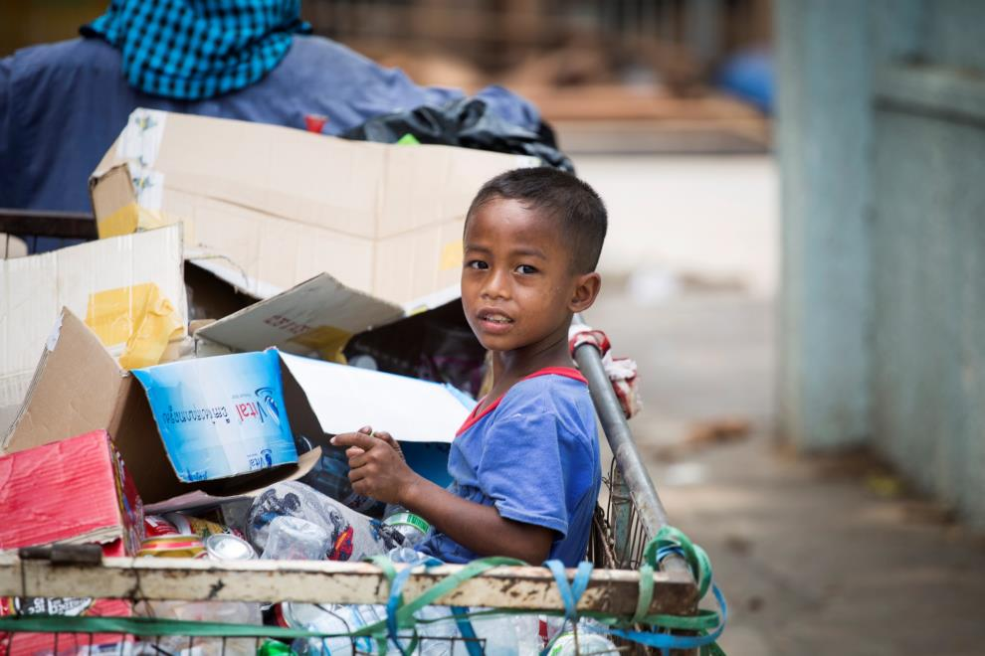
Chamroeun, sechs Jahre alt aus Phnom Penh, Kambodscha. Er geht jeden Tag mit seiner Mutter auf die Straße um Müll zu sammeln, den sie für einen minimalen Betrag verkaufen. Chamroeun wird wahrscheinlich nicht zur Schule gehen können, weil sich das seine Eltern nicht leisten können. Vergangenes Jahr starb seine sechs Monate alte Schwester. Seine Familie hat Angst, dass auch er an vermeidbaren Krankheiten sterben könnte.
© UNICEF/UNI165124/Lovell
Notes:
Six year old Chamroeun helps his mum, Sareth, collect rubbish to sell, every day in Cambodia's capital, Phnom Penh.Sareth comes home at lunchtime, pulls a bundle of banknotes from her top pocket and starts counting. They add up to the equivalent of around 60 pence. She’s been out all morning collecting old cans and plastic bottles from the streets to sell in order to buy food for her family. In October last year, Sareth’s six month old only daughter died after becoming sick with diarrhoea. “I breastfed her in the morning, around 6 or 7 o’clock,” she says as tears fill her eyes, “and then I went out to collect rubbish. At the time there was flooding and sewage up to here,” she recalls, pointing to a waist height wooden slab, a makeshift ‘bed’ where her daughter lay when she was sick. She holds her hands tightly together. “We took her to the hospital but they couldn’t help and she died. I feel so sad about it.” Sareth, 42, lives with her husband and three sons in an urban poor community just a stone’s throw from the main streets of Phnom Penh. They rent their home for £30 a month; a one room corrugated shelter, running alongside the polluted river. The overcrowded area, strewn with rubbish and defecation, is home to more than 2,700 people and it’s one of approximately 500 urban poor communities in the capital of Cambodia. There’s little space for children to play, and limited access to safe water, sanitation and healthcare.Sareth’s husband comes out of their home clutching a photo of his baby daughter and it’s clear she is still at the front of all their minds. “I tried to protect her from diseases but it was hard,” Sareth continues. “I don’t understand how other children were fine, but not mine. Now I know the dangers of diarrhoea but I worry about it.” Around 50 children under the age of five die every day in Cambodia from diseases that can be easily prevented and treated, such as diarrhoea and pneumonia. UNICEF and its partners are working around the clock to provide much needed support to vulnerable children like those living in Phnom Penh’s urban poor communities.Sareth’s priority now is to look after her three boys. “It’s hard to advise them about life,” she says as she pulls her youngest, Chamroeun, closer on her lap. At just six years old, Chamroeun accompanies his mum on most days to help her collect rubbish to sell. “I didn’t take him today because it was too hot. I was afraid he would get sick so he stayed at home.” “If I don’t have enough money after I’ve sold the cans and bottles, I buy each of them an egg,” she says, smiling. “That’s what we’re having today.”

Slide 13
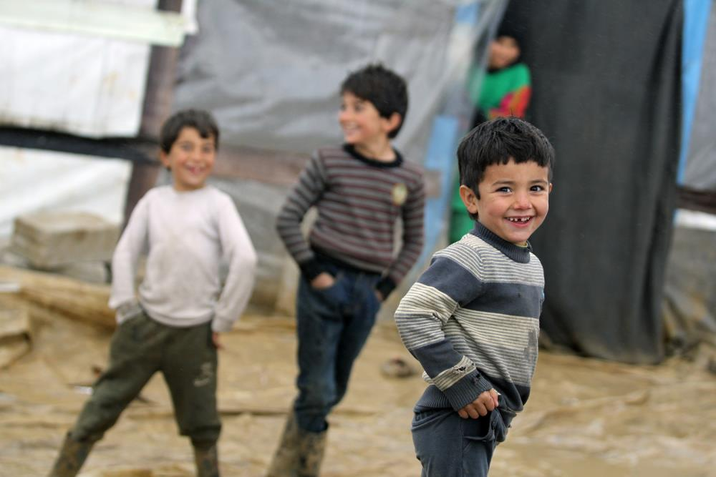
Syrisches Flüchtlingskind, etwa sechs Jahre alt, das in einem informellen Siedlungsgebiet im Bekka-Tal im Libanon lebt. Er und seine Familie mussten aufgrund des Syrienkriegs flüchten und leben nun in einem Zelt. Die meisten syrischen Kinder dort haben durch Hilfsorganisationen wie UNICEF oder UNHCR nun die Möglichkeit eine temporäre Schule zu besuchen. Jedoch sind viele Kinder durch den Krieg verstört und krank. Ihre Zukunft ist sehr ungewiss.
© UNICEF/UN07740/Kljajo
Notes:
On January 5 2016 in Lebanon, three Syrian refugee children playing in their informal settlement Al Faida, in the Bekaa Valley. In 2015-2016, UNICEF Lebanon aims to provide assistance to 381,114 vulnerable Syrian and Palestinian refugee children, and socio-economically poor Lebanese children, living in areas exposed to winter conditions. The types of assistance includes unconditional one-time child cash for winter, winter clothes for children and fuel for heating in schools. Building on the experience of the 2014-2015 Winter Programme, UNICEF is shifting from in-kind assistance to cash assistance. It is an empowering and dignified form of support to children and their families, with a positive effect on the local economy and with lower administrative costs.

Slide 14
Diskussionsrunde
Haben die Rollen miteinander zu tun?
Gibt es in Österreich oder auf der Welt unabhängig von diesen Rollen Menschen, die weiter hinten stehen würden?
Worum geht es in diesem Spiel?
Was hat das mit Bildung zu tun?
Warum ist Bildung so wichtig?
Warum sollte man Bildung für Alle unterstützen?

Slide 15
KONTAKT
UNICEF Österreich
Mariahilfer Straße 176/10, A-1150 Wien
T +43 1 879 21 91
Web: www.unicef.at
E-Mail: geissler@unicef.at
www.facebook.com/unicefoesterreich

